Slide 1


Spatial Semantic Pointers (SSPs)
Chris Eliasmith
SYDE 556/750

Slide 2
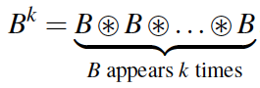
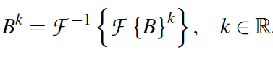
Spatial Semantic Pointers
Semantic pointers represent standard discrete structures (lists, trees, etc.)
SSPs allow recurrent convolutions to have fractional powers
Compute fractional k in Fourier space

Slide 3
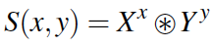
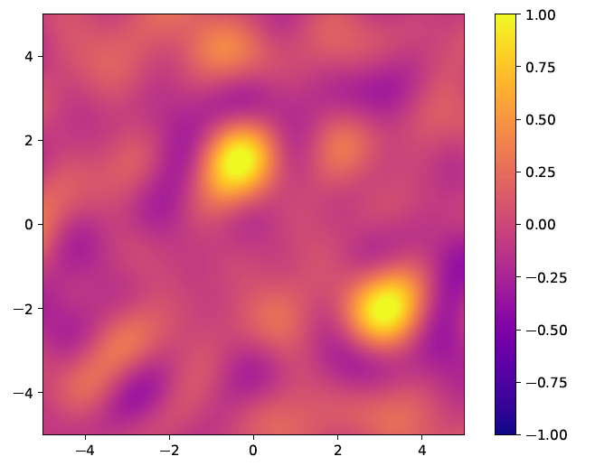
Spatial Semantic Pointers
Represent continuous space (Clifford torus)
Heat map to visualize vector contents
Dot product between SSP at every possible position and S
Notes:
Clifford torus: preserves Euclidean geometry. This is a generalization to any number of dimensions of the torus (usually just 4D); ‘proper’ cartesian product of circles (not a 3 torus)

Slide 4
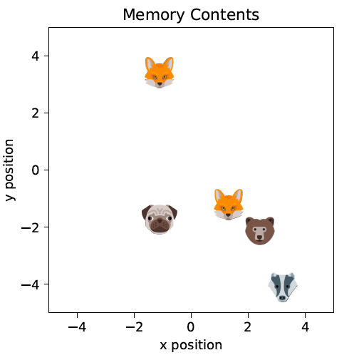
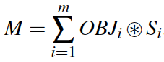
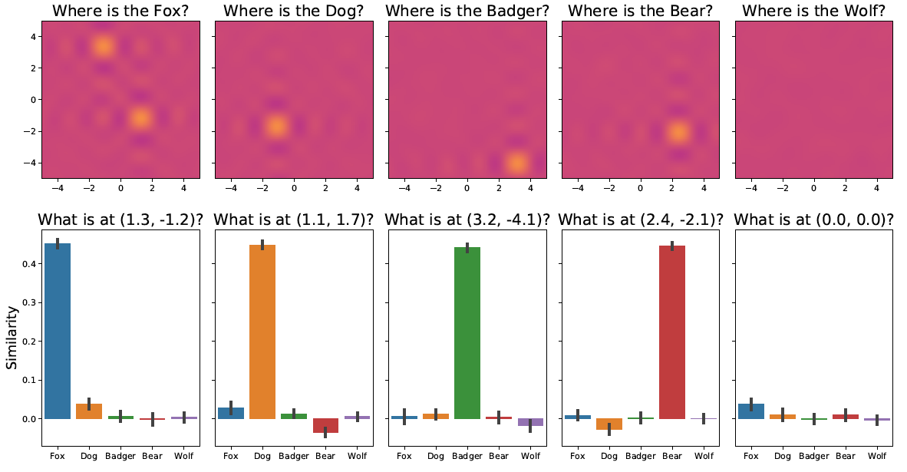

Slide 5
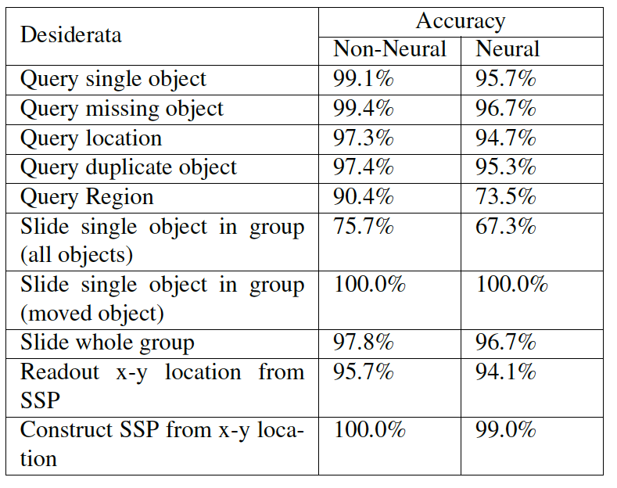
Spatial Manipulations

Slide 6
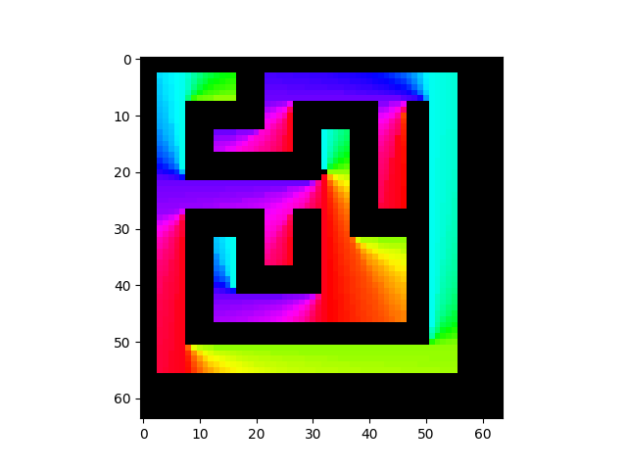
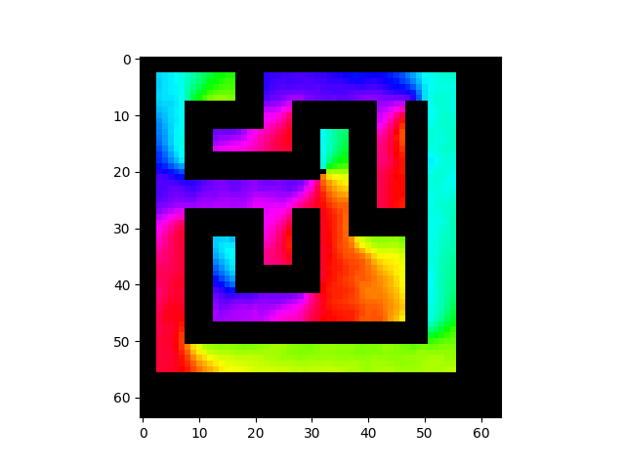
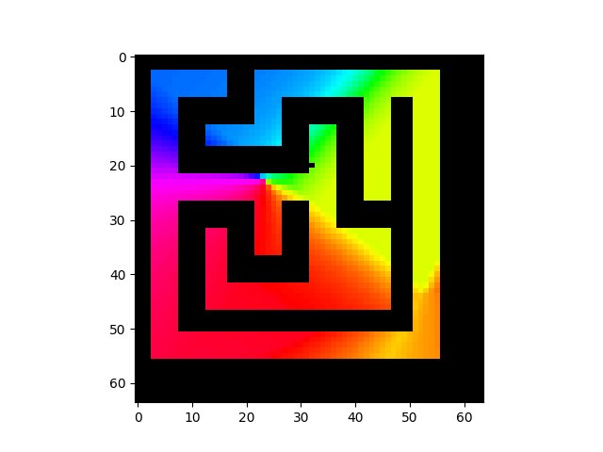

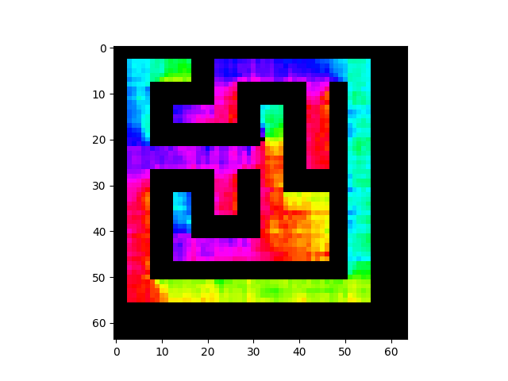
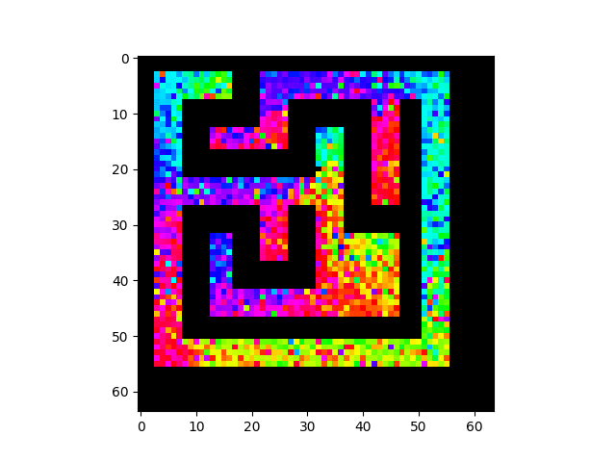
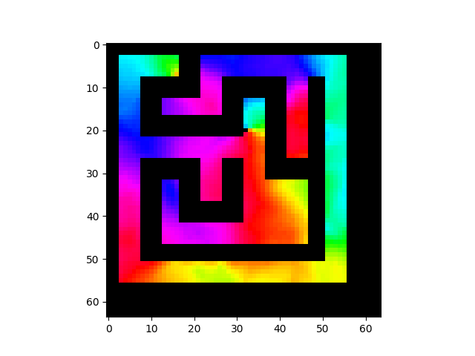

Navigating to Goal
Ground Truth
RMSE: 0
SSPs
RMSE: 0.0529
Random Projection
RMSE: 0.5351
Single layer MLP, same for each encoding (tried many more).
Trig Functions
RMSE: 0.1350
Random Mapping
RMSE: 0.2580
2D Coordinates
RMSE 0.1984
Legend
Up
Left
Right
Down
Notes:
Keep diagram on this slide, and explain the different methods

Slide 7
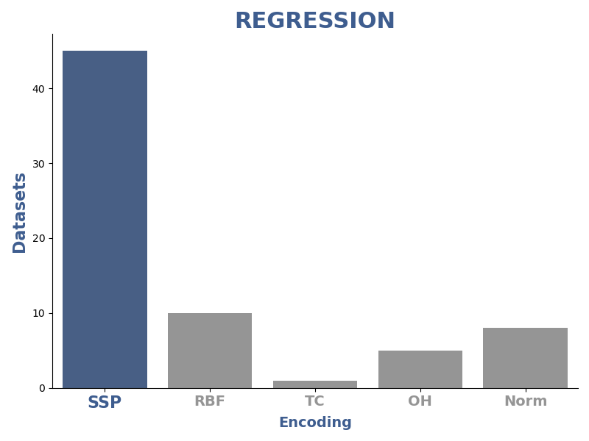
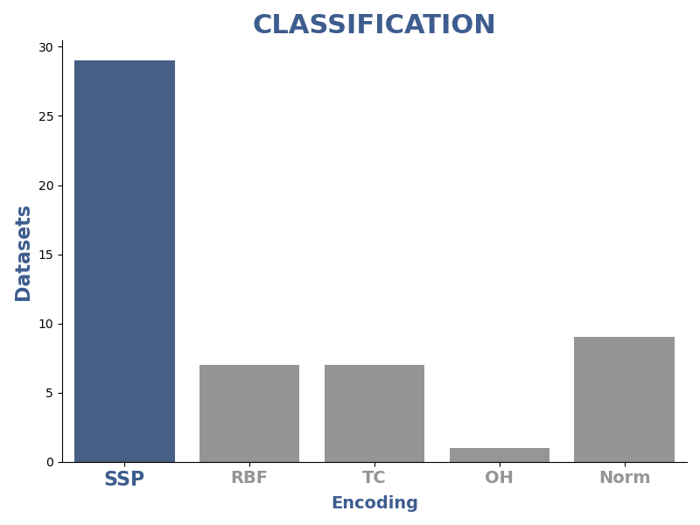
Good for General ML
SSPs are more accurate on a large majority of 122 standard ML benchmarks.

Slide 8
Scaling
Example 10x10 joined, hierarchical environment

Slide 9
Scaling
Performance of different encoders on 10x10 large maze from any point to any other

Slide 10
How to Choose Axis Vectors
Randomly (examples til now)
Tuning curves of neurons with random axis vectors and evenly tiled SSPs as encoders

Slide 11
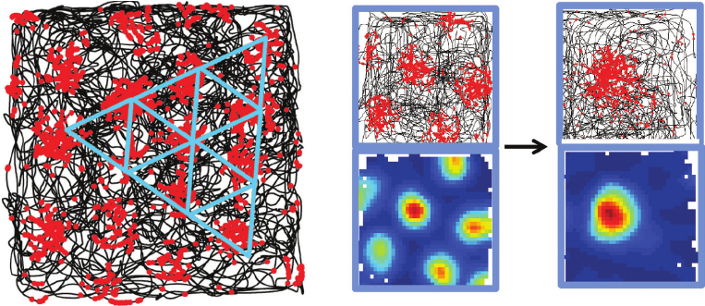
Empirical Grid Cells
Grid cells in rat entorhinal cortex (Moser et al., 2015)

Slide 12
How to Choose Axis Vectors
With plane wave structure
Tuning curves of neurons with structured axis vectors and encoders picking out plane waves

Slide 13
How to Choose Axis Vectors
Sums of planar waves

Slide 14
Grid Cells
With plane wave structure, spiking neurons give grid cell responses
We can combine them to get place cells (with standard NEF decoders)
SSP Grid cells

Slide 15
Place Cells
Distance between ideal and represented place cells

Slide 16
Mathematical properties
Euclidean space is preserved on a high-d torus
E.g.,
We get the benefits of high-d representation, with accurate low-d Euclidean representation

Slide 17
Cognitive SLAM
SLAM with complex features at certain spatial locations
Start with no knowledge, bind vector descriptions to particular location in space
Combines spatial and ‘symbol’ repn in neural network
Semantic map as opposed to standard ‘image registration’ map

Slide 18
Cognitive SLAM Model
Full Model
Path Integrator
Path integrator tracks ego position from velocity
SLAM model learns env map, outputs allo- and ego-centric position

Slide 19
Path Integration
One-minute long paths in 2D and 3D, spiking network

Slide 20
Cognitive SLAM
Learns env by end of 20s path, full spiking
Scaling up; symbols ‘over’ space
Notes:
(a) The path and
items along it (marked by coloured shapes). The ‘x’ markers
indicate recalled item locations at the end of the simulation.
(b) The error in recollection of the item locations as SSPs over
time, where the error is equal to the absolute value of the difference
between one and the similarity of the recalled vector
to the true vector. The markers on the time axis show when
the items appeared along the path. (c) Error in the model’s
estimate of the vector between items and self-position.

Slide 21
Cognitive SLAM
Learns maps in LTM bound to position

Slide 22
Navigation network
Combined the above into a network to recall location and navigate to arbitrary objects in a maze.

Slide 23
SSPs as Probabilities
SSPs can be a method for encoding and processing probabilities
Method directly connects neural networks to probabilistic reasoning
SSP based methods are efficient

Slide 24
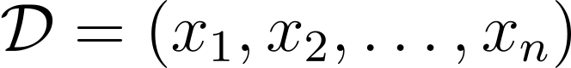
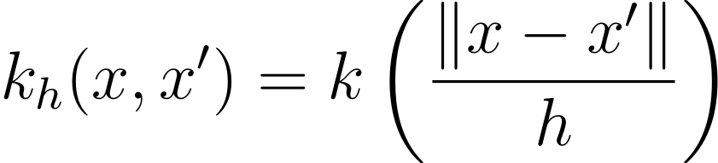
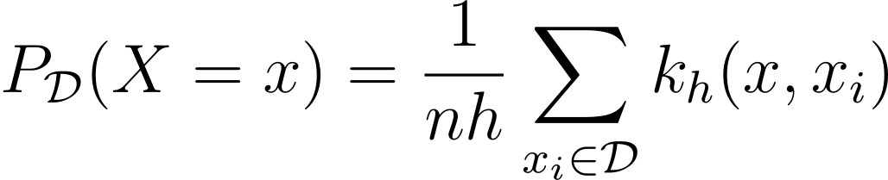
SSPs as Probabilities
Background
Kernel Density Estimators
From a dataset
With a kernel function
We can estimate the probability of x

Slide 25
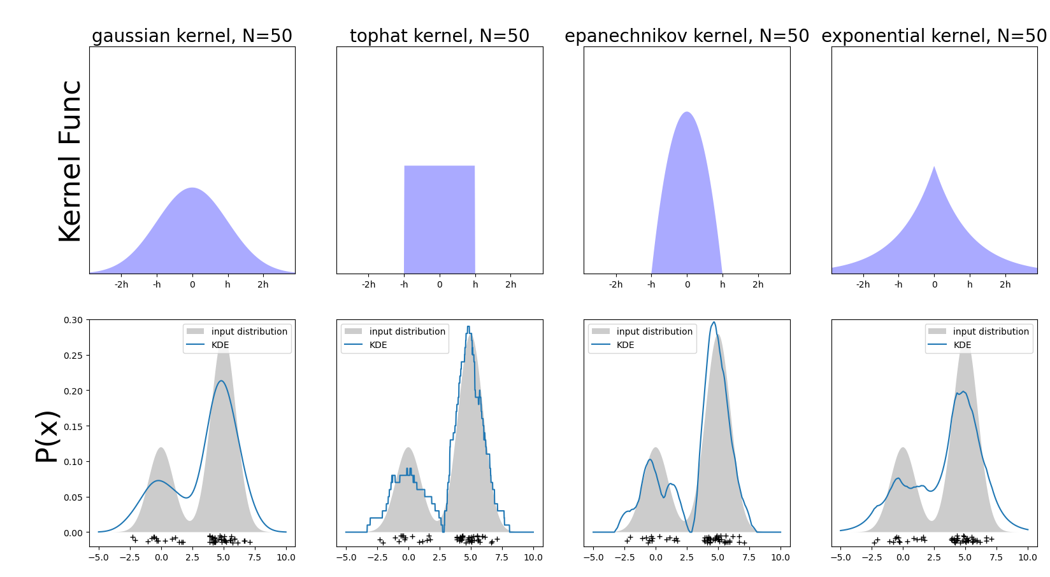
SSPs as Probabilities
Kernel Density Estimators Examples

Slide 26
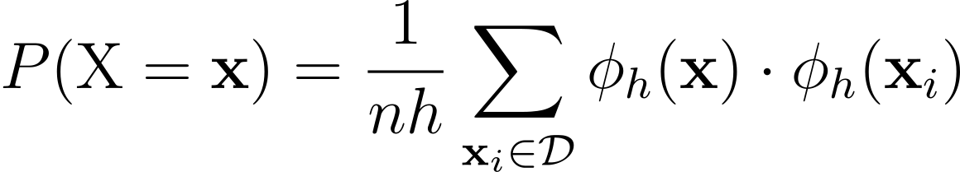
SSPs as Probabilities
Problems
KDE memory grows linearly with the number of observations
KDE time to compute a probability grow linearly with # of observations
But…
Not if your kernel is a dot product

Slide 27
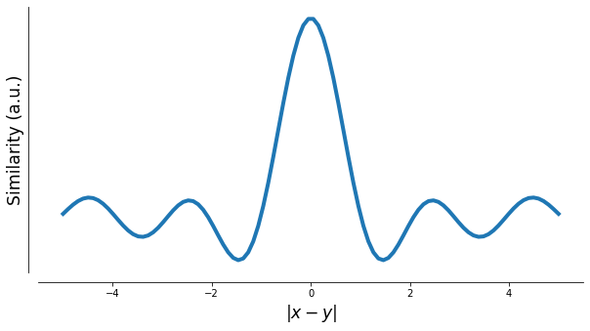
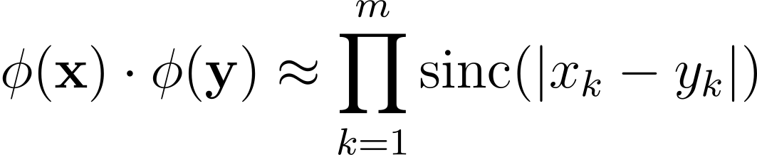
SSPs as Probabilities
SSPs induce a quasi-kernel
‘quasi’ because there are negatives

Slide 28
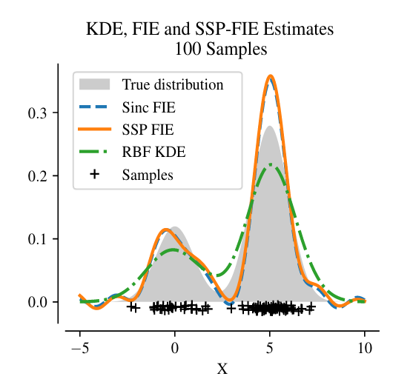
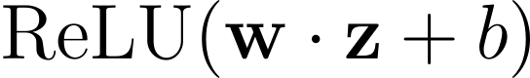
SSPs as Probabilities
Can convert to probability estimator
Glad et al, 2003

Slide 29
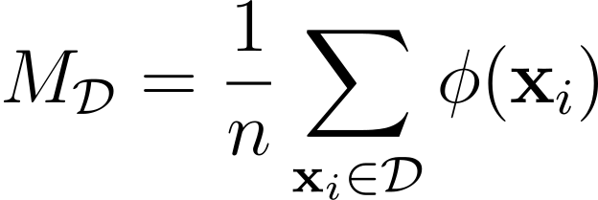
SSPs as Probabilities
So SSP memory is a latent probability distribution
The distribution is stored in bundles of vector symbols.
We can apply manipulations to bundles to produce probabilistic statements

Slide 30
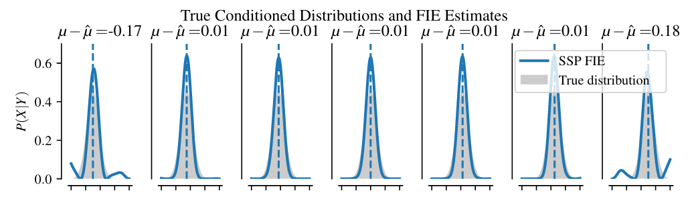
SSPs as Probabilities
Conditioning

Slide 31
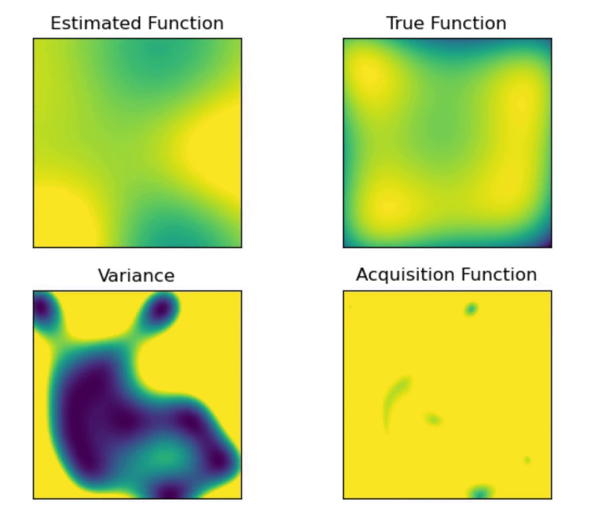
SSPs as Probabilities
Mutual Information (MI) is a common objective function used in exploration
Gaussian Processes (GPs) are a convenient, but computationally intensive tool for computing MI
We use Spatial Semantic Pointers and Bayesian linear regression to approximate a GP while improving in memory and time complexity
μ_{t}(x)
σ²_{t}(x)

Slide 32
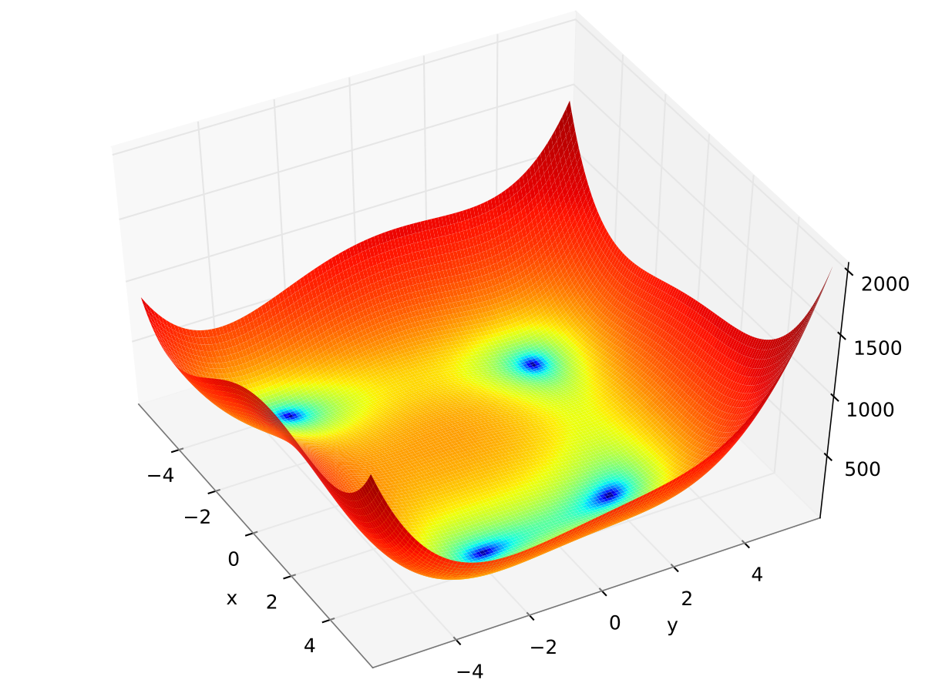
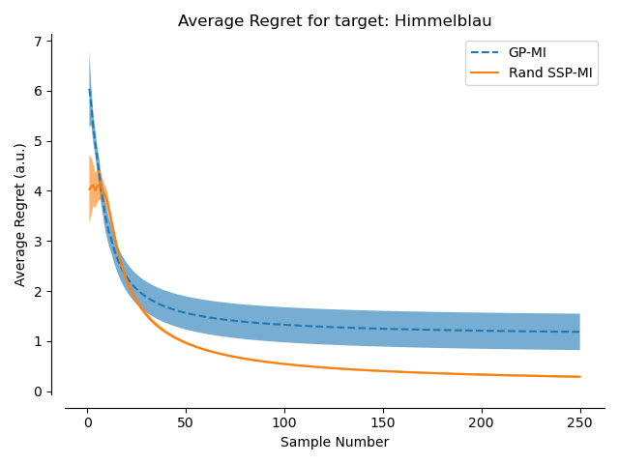
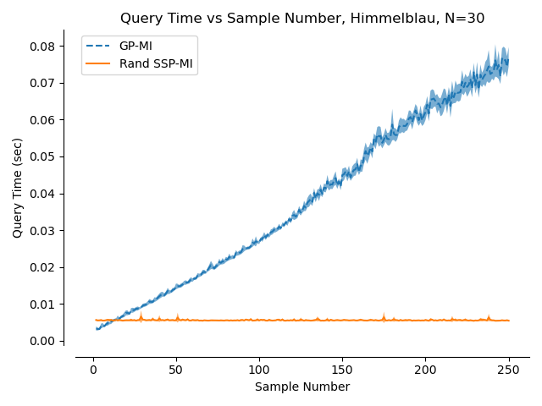
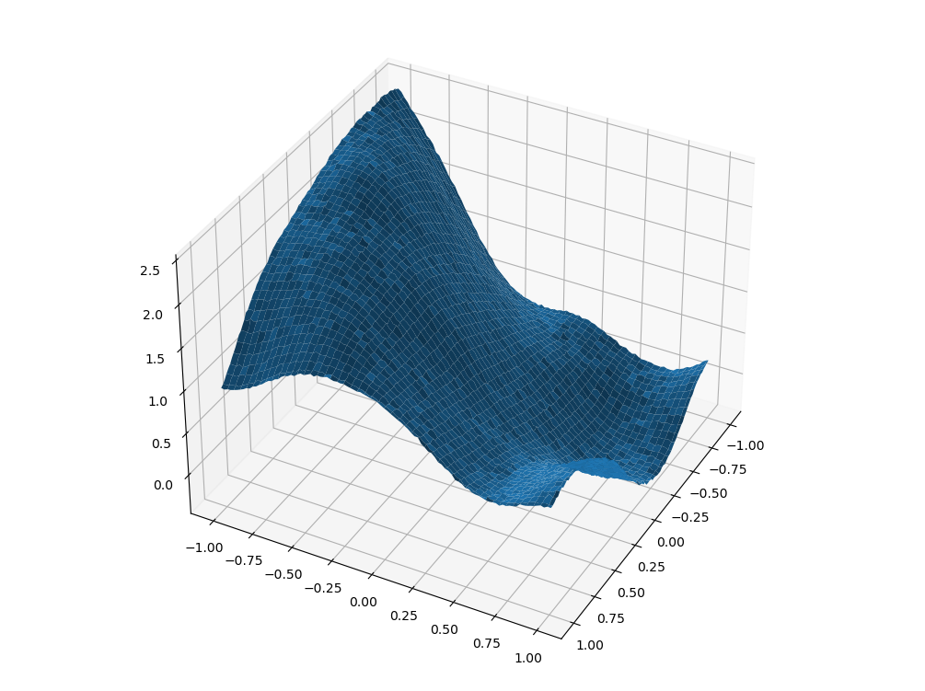
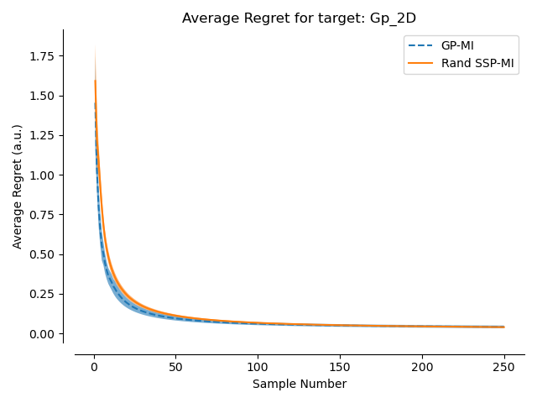
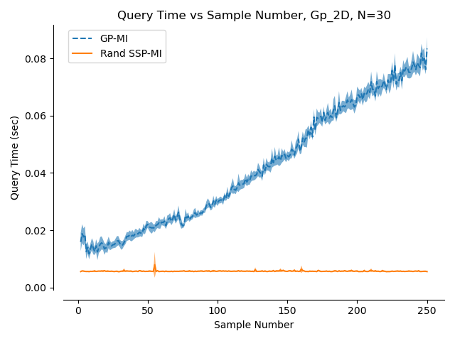
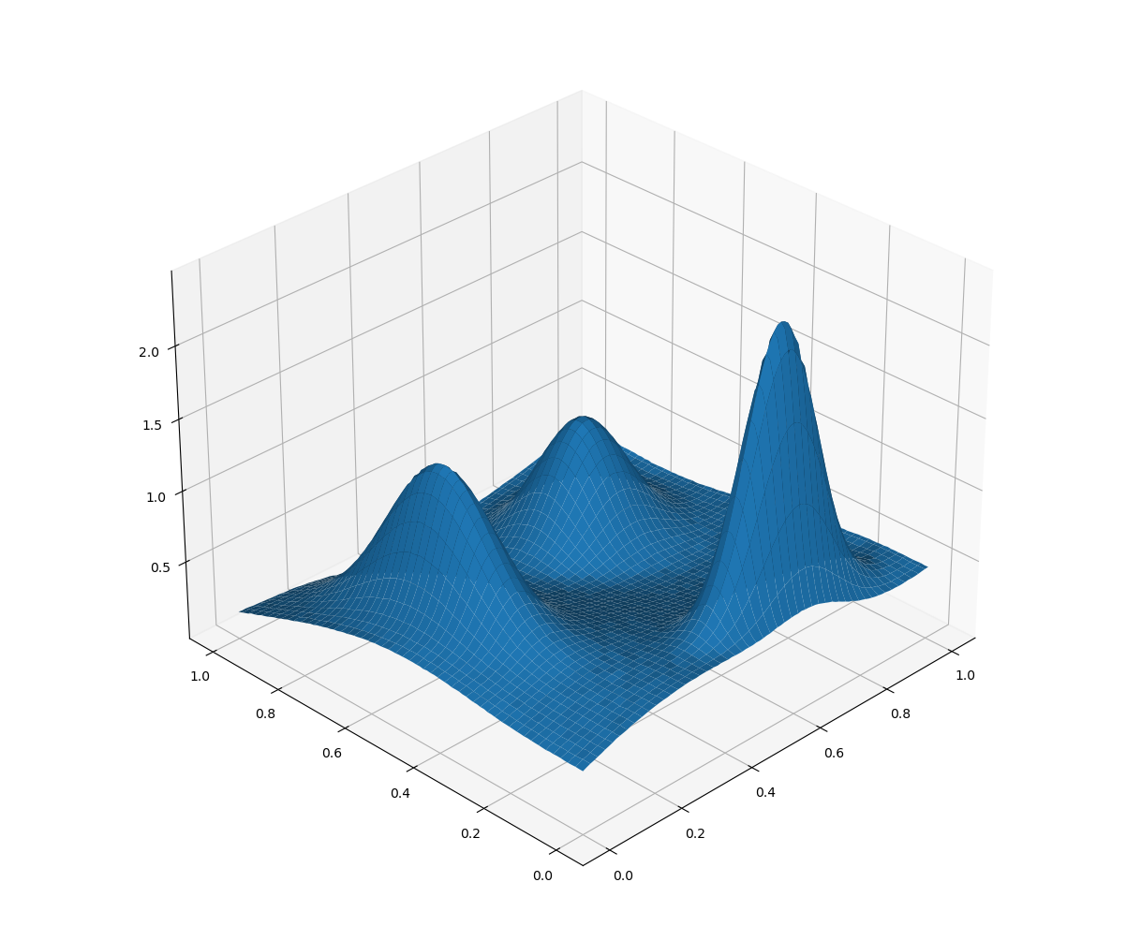
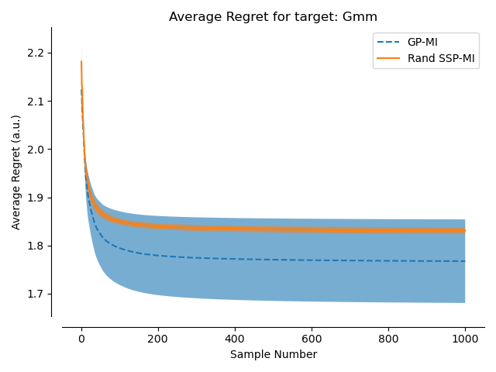
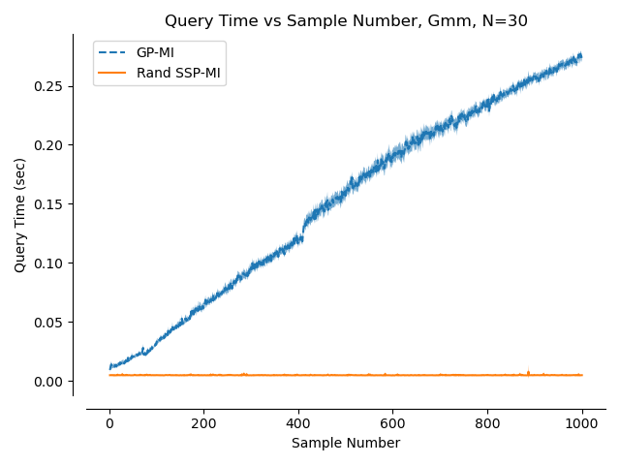
Results
Himmelblau Function
Sampled from GP with Matern Kernel + 1% noise
GMM with noise ~ (Matern Kernel + 1% noise)

Slide 33
SSPs for Sampling
Current methods require knowledge not accessible to a neural system (e.g. the encoding, gradients)
We use Langevin dynamics to do MCMC sampling with SSPs
Supports conditioning easily as well
Turns latent repns into samples in an encoding agnostic manner
Notes:
- Encoding agnostic because other methods have to go back to the ‘encoded space’ to do the sampling at some point, we don’t… all in SSP space

Slide 34
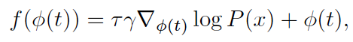
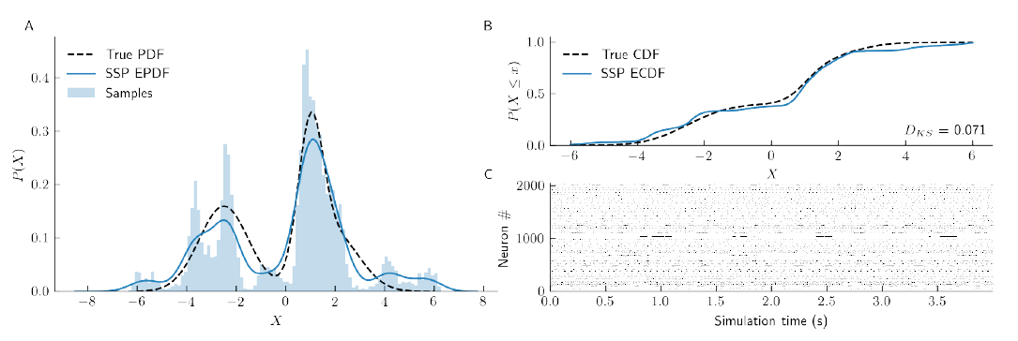
SSPs for Sampling
Implementing the dynamics in a SNN generates effective samples
Notes:
Plots show distributions represented by μXY ⊛ ϕ−1Y (y), for y ∈ {−6, 0},
where μXY is a kernel embedding of a 2D GMM model. Blue dots (vertical positions are
randomly assigned) indicate the 2000 samples drawn from the distribution. B. Sampling
a joint distribution over the space {A,B,C} °ø [0, 1].

Slide 35
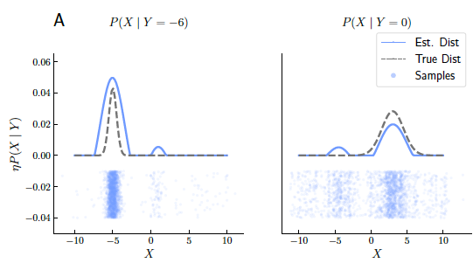
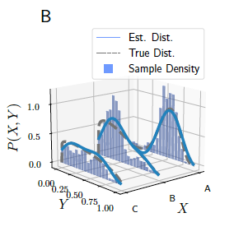
SSPs for Sampling
Sampling using dynamics for both continuous and discrete PDFs
2D Gaussian Mixture Model
Hybrid Discrete/Continuous
Notes:
Plots show distributions represented by μXY ⊛ ϕ−1Y (y), for y ∈ {−6, 0},
where μXY is a kernel embedding of a 2D GMM model. Blue dots (vertical positions are
randomly assigned) indicate the 2000 samples drawn from the distribution. B. Sampling
a joint distribution over the space {A,B,C} °ø [0, 1].

Slide 36
SSPs as Probabilities
Where we differ:
Provide a general and abstract framework for modelling probabilities
Draw a direct connection between cognitive models and probability statements
Provide network architectures for conditioning, marginalization, entropy, sampling, and mutual information

Slide 37
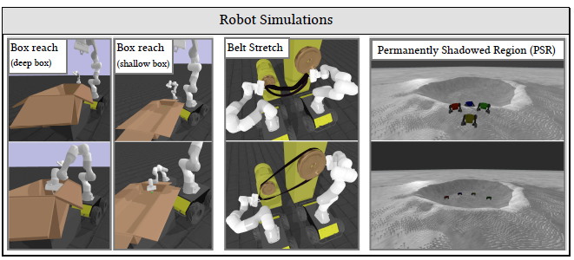
SSPs for Optimization
Three difficult optimization problems
Notes:
In Box Reach, the objective is to quickly reach a target within a box (The two arms have different sizes.
The smaller arm is able to reach into smaller boxes, but not larger boxes. The other arm is larger and can reach into boxes of all heights, but moves slower).
In Belt Stretch, two arms must collaborate to place an elastic belt on a motor and gear assembly.
In PSR, multiple robots explore the permanently shadowed of a crater to find water.

Slide 38
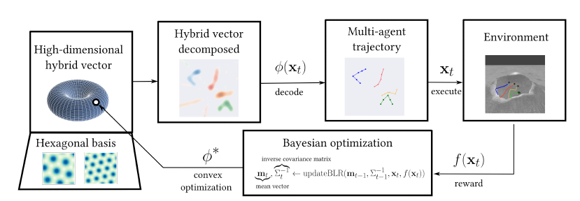
SSPs for Optimization
We use SSPs to represent possible trajectories
- Hybrid repn: sum(agent*trajectory)

Slide 39
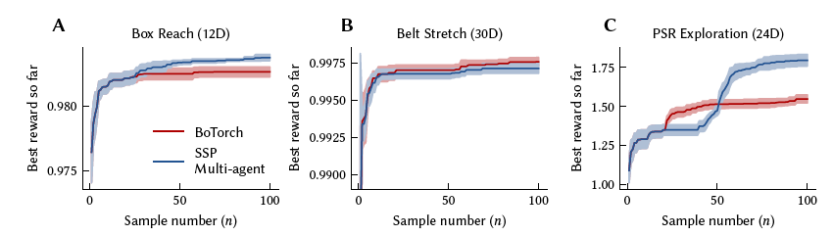
SSPs for Optimization
As good or better performance than SoA
Notes:
Uses: action selection, predicting future events, estimating integrals, etc.

Slide 40
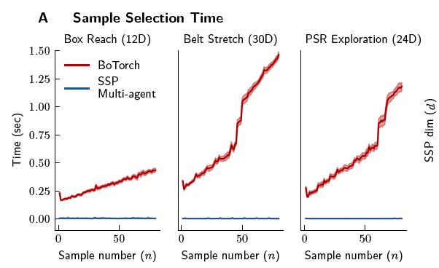
SSPs for Optimization
Much faster (53x-175x)
- From O(N³) to O(1) in number of samples
Notes:
Uses: action selection, predicting future events, estimating integrals, etc.

Slide 41
Conclusion
SSPs support a variety of types of inference for cognitive models
Binding spatial and ‘symbolic’ representations
Representations of sampled data that can be used for probabilistic inference
Improves
Interpretability
Efficiency (SWaP critical)
Best engineered systems continue to learn from understanding biological solutions

